Slide 1
A planning assignment that looked successful
Spaces of Human Interaction
The assignment
Create a photo shoot plan before going out to take photographs.
“I wanted students to use AI as part of the project, not to complete the project.”
Notes:
Start before the title slide. Explain you were trying to use AI in the classroom without letting it do the learning. The assignment was to photograph spaces of human interaction. Students needed to build a photo shoot plan first.

Slide 2
Same prompt. Two different plans.
Both students began from the same teacher-created prompt.
Teacher prompt: “Help me build a photo shoot schedule. Ask me about locations, equipment, and time.”
Seattle Plan
Park Plan
Location: Downtown, waterfront, University District
Time: Afternoon into golden hour
Equipment: DSLR, standard lens, telephoto, macro
Subjects: Fish market, UW students, business people, waterfront landmarks
Location: Park within walking distance
Time: Saturday, 9:30 to noon
Equipment: Phone camera
Subjects: Sibling on playground, people walking dogs, self-timer backup
Based only on these plans, which student will produce the stronger photographs?
Notes:
Do not ask for a show of hands. Point out how the Seattle plan uses classroom vocabulary: golden hour, DSLR, lenses, locations. Then note the park plan looks less impressive at first glance.

Slide 3

One plan sounded stronger. One plan happened.
The outcome changes how we judge the evidence.
SEATTLE OUTCOME
PARK OUTCOME
NO PHOTO SHOOT
SUBMITTED
No ride. No available time. No plan to go.
Completed assignment
“One plan sounded like a great photo shoot. The other one was a real plan.”
Notes:
Reveal transportation, schedule, access, and intent. The Seattle student had no ride, no time, and no plan to go. The park plan was possible. Let the laugh land.

Slide 4
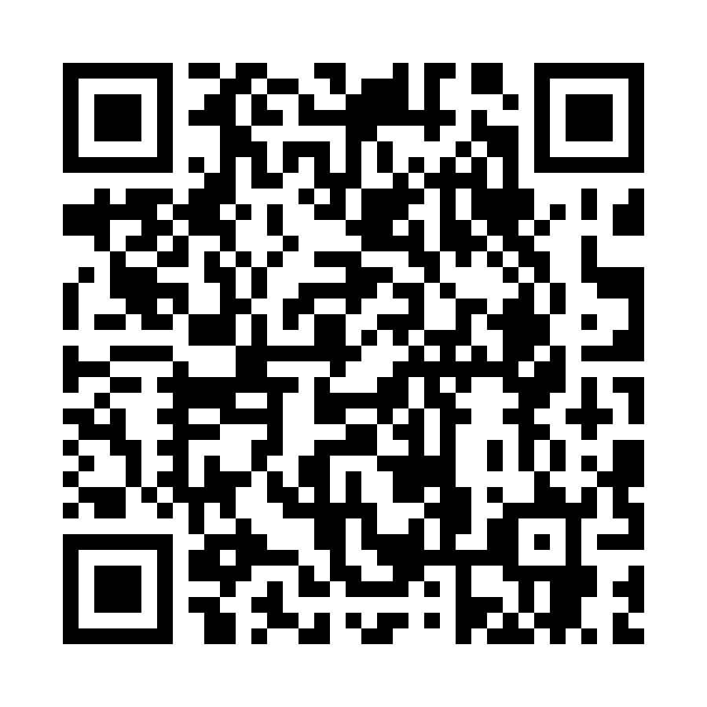

AI That Thinks
With Students,
Not For Them
WA-ACTE Summer Conference 2026 • Spokane
LASERSLOTH
MEDIA
Paul Warrick
Photography • Business • Computer Science
PUBLISHING THAT GROWS IDEAS
Notes:
After the reveal, introduce yourself briefly. Keep it short. The story already created the reason for the session.

Slide 5
The central shift
AI should reveal student thinking, not hide it behind polished output.
A finished product proves something was produced.
A thoughtful process shows who made decisions and why.
Reveal
Build
Collect
Student decisions, process, and learning
Prompts that probe, clarify, and preserve ownership
Evidence without a separate paperwork system
The final product no longer stands as our only evidence.
Notes:
Promise: What I want you to leave with today is a different way to use AI in the classroom, as a tool for revealing the thinking behind student decisions, their process, and their learning.

Slide 6
Answer tool vs. thinking partner
The role we assign AI changes the evidence we get.
ANSWER TOOL
THINKING PARTNER
Produces something for the student.
Accepts vague details.
Moves quickly toward a final product.
Can hide who did the thinking.
Asks before answering.
Probes shallow responses.
Tests feasibility when needed.
Makes decisions visible.
“A thinking partner does the one-on-one questioning we wish every student received.”
Notes:
Explain why you started using the term thinking partner with students. It clarifies that AI is not an answer generator. It helps pull out memories, reasoning, choices, and questions.

Slide 7
What “thinking” looks like in the chat
The student drives the conversation. AI draws out the process.
PROBE
CLARIFY
“Tell me more about why you chose this.”
“What do you mean by somewhere nearby?”
TEST
EXTEND
“How will you get there, and how long will travel take?”
“Try one lower angle, one close-up, and one motion shot.”
AI does not challenge every student. It listens for answers that need examination.
Notes:
Key distinction: AI does not need to challenge every student. It listens for answers needing more examination.

Slide 8
Better prompts carry teacher judgment
AI needs the context you usually hold in your head.
Role
What kind of partner should AI be?
Information
Who are the students? What limits matter?
Steps
Ask one question at a time. Probe, clarify, pause.
Exclusions
What should AI not do?
Deliverable
What decision trail should students submit?
Prompt design is teaching design.
Notes:
Use the photography assignment to show how the original prompt lacked context, feasibility checks, and boundaries.

Slide 9
A stronger photo-planning prompt
Conditional follow-up questions preserve ownership without slowing every student down.
Act as a photo shoot planning manager for high school students in Lakewood, Washington. Ask one question at a time about location, transportation, schedule, equipment, subjects, and backup plans. Probe vague or unrealistic answers, especially when access or travel may be difficult. Do not make decisions for the student. After the student sets the direction, suggest optional ideas for lighting, angles, motion, composition, or camera settings. When the plan is complete, summarize the location, time, transportation, equipment, shot list, and backup plan.
Student ownership does not mean AI never offers ideas. AI waits until the student supplies the direction.
Notes:
Emphasize: ask the student for a backup location before AI suggests one. AI can offer technical variants after the student establishes their plan.

Slide 10
The learning cycle
AI supports the beginning and the end. The student performs the work in the middle.
1. PLAN WITH AI
2. PRODUCE THE WORK
3. REFLECT WITH AI
Photo shoot plan
Constraints
Shot list
Backup options
Take photographs
Select images
Build presentation
Compare plan to results
Identify changes
Name growth
→
→
“AI helped the student prepare for the work, then make sense of the work. It did not take the photographs.”
Notes:
There are three deliverables: plan, produced work, reflective conversation. The first and third use AI. The middle is the student work.

Slide 11
Reflection shows what the product cannot
Students often identify growth more honestly than we expect.
What changed from your plan?
Reflection moves improvement from something the teacher assigns to something the student recognizes.
What worked?
What surprised you?
What would you do differently?
What pattern do you notice in your work?
Project reflections become evidence for future growth goals.
Notes:
Students are often harder on themselves. They talk about time slipping away, not taking enough photos, or missing opportunities. That is evidence of ownership.

Slide 12
Teacher win: individualized evidence
Student thinking also creates usable artifacts for evaluation.
STUDENT-OWNED
DOCUMENTED
MANAGEABLE
Individual growth goals grounded in their own reflections.
Reflection artifacts ready to review, track, and upload.
Stronger evidence without building a separate paperwork system.
“You now have individual goals, evidence of reflection, and artifacts you can upload. The students did the thinking.”
Notes:
Use humor here: This starts looking suspiciously like leveled-up teaching. Students build authentic evidence while you track it.

Slide 13
Your turn: assignment cards
Collect real classroom ideas for the live demo and follow-up.
AI THINKING PARTNER ASSIGNMENT CARD
WHILE THEY WRITE
Assignment:
• Take two quick questions
• Walk the room and collect cards
• Select one clear assignment
• Avoid random-draw chaos
What should students learn?
What should AI not do?
☐ Email me sample prompts
Email: __________________________
☐ Under no circumstances should Paul contact me about this assignment.
“I’m going to steal one of your assignments and see whether we can build a better prompt together.”
Notes:
Give them about two minutes to write, then take questions while collecting the cards. The humorous checkbox makes the room laugh and keeps follow-up optional.

Slide 14
Live demo: building the prompt together
Teacher knowledge plus AI questioning becomes a usable classroom prompt.
Paul: “Stacy, are you ready to help me build a thinking-partner prompt for this assignment?”
Stacy: “I’m ready. Tell me what students must produce and what learning needs to stay with them.”
Assignment
→
Learning goal
→
AI role
→
Exclusions
→
Follow-up rules
→
Final summary
The prompt comes from conversation, not magic wording.
You know the students, assignment, and learning goal. Your thinking partner helps identify missing boundaries.
Notes:
Explain that you are not asking Stacy to write a prompt for you. You know the students, the assignment, and the learning goal. Stacy helps you find the missing boundaries.

Slide 15
Demo result: business identity prompt
A copy-and-paste prompt for the graphic design assignment.
You are a thinking partner, not an answer generator. Help me build a business by asking one question at a time. Guide me to define the business name, target audience, mission, location, and brand guidelines. Explain what different colors and fonts often signal, but do not choose for me. Never make decisions on my behalf. If I give a one-word, vague, or ambiguous answer, ask follow-up questions until my thinking is clear before moving on. When we finish, summarize all of my decisions for the next assignment. Do not create a logo. Only help me develop the business and its brand identity.
Logo design comes next. This prompt builds the business and brand foundation.
Notes:
Read only enough for people to understand the structure. The slide deck gives them the full prompt later.

Slide 16
Q&A
What questions do you have about using AI this way, or about an assignment you are thinking about?
Student ownership • Visible thinking • Manageable teacher workflow
Notes:
Use backup Q&A slides later if needed: integrity, grading workload, privacy, access, inaccurate AI responses, and what to do when AI gives an answer too early.

Slide 17
Backup: common questions
Use only if these come up during Q&A.
Academic integrity
Grading workload
Focus on decisions, revisions, explanations, and reflections.
Grade the evidence trail, not every line of the transcript.
AI gives answers too early
Inaccurate AI responses
Add exclusions and pause points: ask, probe, summarize only when complete.
Use AI for questioning and reflection where student context drives the work.
Backup slide, not part of the 40-minute plan.

