Slide 1
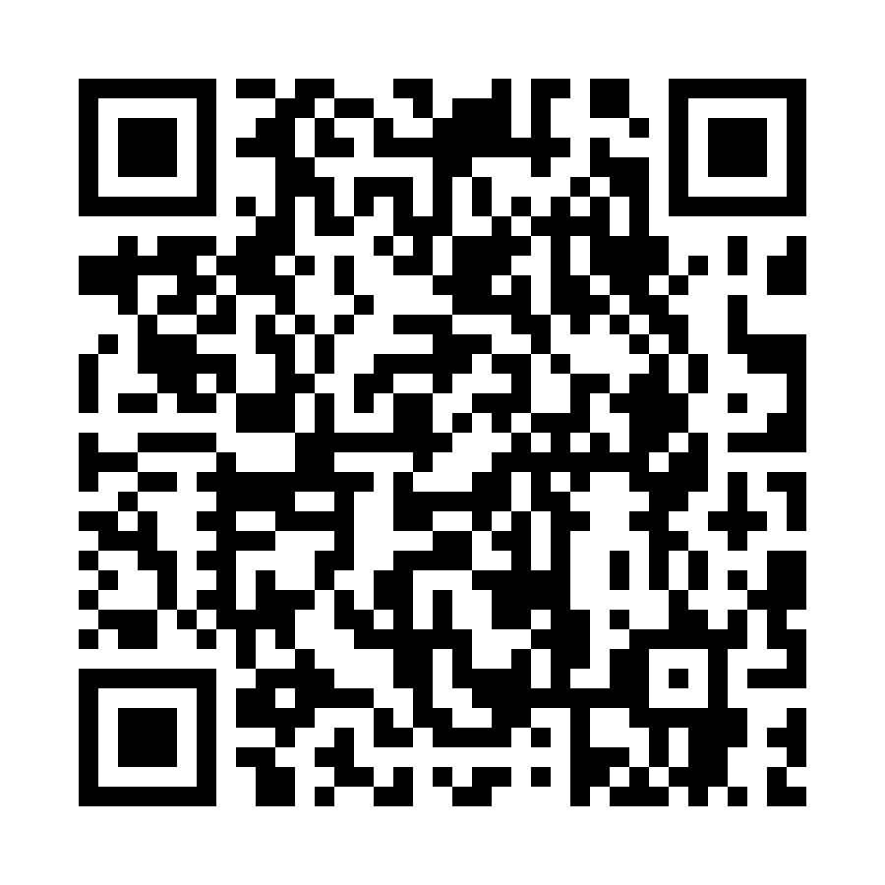
Chatting with
Stacy
Building a better relationship with your AI assistant
LASERSLOTH
MEDIA
WA-ACTE Summer Conference 2026 • Spokane
Paul Warrick
Photography • Business • Computer Science
PUBLISHING THAT GROWS IDEAS
Notes:
Start conversationally. This session is less about a formal framework and more about showing how Paul and Stacy work together. Mention this is the second of three back-to-back sessions if it helps the room understand the pace.

Slide 2
First, a boundary
An assistant should make teacher thinking clearer, not replace teacher relationships.
Do not lead with grading
Lead with communication
Keep responsibility visible
I am not building this session around AI correcting essays, grading tests, or writing student feedback. Those are places where teachers can lose touch with student thinking.
Correspondence shows the assistant role clearly: audience, purpose, tone, missing information, and possible misreading before the draft.
AI can help organize the message. The teacher supplies facts, judgment, and final approval. The human stays responsible.
A good AI assistant does not begin by rewriting your message. It begins by helping you decide what the message needs to accomplish.
LASERSLOTH MEDIA
2
Notes:
Use this slide to set ethical and practical boundaries. Say you are avoiding grading and feedback shortcuts because those can cost teachers an opportunity to know students.

Slide 3
What “Stacy” is
A name for an ongoing working relationship, not a separate product.
Not a platform.
Not a magic prompt.
Not a replacement teacher.
Stacy is how I use ChatGPT as a thinking partner.
I bring the context, constraints, students, and professional judgment.
The assistant asks questions, finds gaps, drafts options, and helps me make the work clearer.
The relationship matters more than the first prompt.
LASERSLOTH MEDIA
3
Notes:
Explain that Stacy is the named relationship you have built with ChatGPT. The point is not branding the AI, it is developing a consistent assistant workflow.

Slide 4
Example 1: correspondence
Turn a blunt message into clear, responsible communication.
Rough teacher message
Stacy asks before drafting
“Your student is missing several assignments and needs to turn them in by Friday, or their grade on the report card is going to be an F. Please talk to them.”
Who is receiving this?
What do you want them to do?
What tone should the message carry?
What deadline matters?
What context should stay out of the email?
Improved writing comes from better decisions, not grammar polish.
LASERSLOTH MEDIA
4
Notes:
Run the parent-email example live or summarize it. Stacy asks about recipients, action, tone, deadline, and what information to leave out.

Slide 5
Correspondence result
The assistant drafts. The teacher owns the message.
Subject: Missing Assignments and Report Card Grade
Good morning,
I am contacting you because [Student Name] currently has several missing assignments in [Course Name]. We have discussed these assignments in class, and [Student Name] has expressed a desire to earn a passing grade.
If the missing work is not submitted by Friday, the upcoming report card will reflect a failing grade. You can review the missing assignments in Skyward. Please ask [Student Name] to open Teams and show you the assignment instructions and any work already completed.
Please reply if you have questions.
Transparency line
Drafted with support from Stacy, Mr. Warrick’s thinking partner.
Why include it?
• Families know AI assisted the wording.
• The facts and judgment remain yours.
• It models responsible AI use for students.
LASERSLOTH MEDIA
5
Notes:
Mention that the tagline is about transparency and trust, not an apology. It also opens conversations about responsible AI use.

Slide 6
Example 2: project design
Business and marketing campaign pitch
Students choose a product, build a marketing plan, create campaign samples, pitch to the class, and reflect using feedback.
1. Plan
2. Execute
3. Present
4. Reflect
Product
Audience
Message
Channels
Timeline
Success measures
30-second commercial
Print ad samples
Campaign pieces
Student-created drafts
Pitch to marketing firm
Audience and value
Campaign choices
Success measures
Use peer feedback
Compare intent to result
Name one growth target
The value is not a generated lesson plan. The value is thinking through ownership, deliverables, checkpoints, and reflection.
LASERSLOTH MEDIA
6
Notes:
This is the main teaching example. Build the marketing project live with Stacy or use this as a condensed version.

Slide 7
Planning with AI
The AI gathers and organizes. The student supplies every major decision.
Planning deliverable
Prompt rules
Summary output
Product
Target audience
Marketing message
Media or channels
Timeline
Measures of success
Ask one question at a time.
Do not create the product, audience, message, channels, timeline, or success measures for the student.
Probe vague answers before moving on.
After the student has made all decisions, summarize the plan under clear headings. Then identify missing considerations or optional areas to think about.
LASERSLOTH MEDIA
7
Notes:
Say the student is not sitting around waiting for inspiration. The planning prompt gets them started by making one decision at a time.

Slide 8
Execution: create first, consult second
AI critiques the draft. It does not become the campaign producer.
Students create:
Then AI reviews for:
• 30-second commercial
• Print ad samples
• Pitch explaining product, audience, message, value, and success measures
• Audience fit
• Message clarity
• Consistency
• Visual impact
• Alignment with the original plan
The student must have something to defend before AI has something to critique.
Boundary: AI offers revision options. The student chooses what changes.
LASERSLOTH MEDIA
8
Notes:
Use the phrase Create first. Consult second. The student brings a draft before AI gives feedback.

Slide 9
Reflection with AI
Use peer feedback to help students name growth.
Inputs
Questions
Output
Original marketing plan
Final campaign materials
Presentation notes
Five peer feedback forms
What changed?
What feedback appeared more than once?
How well did the campaign match the audience?
How did you feel about preparation and presentation?
A reflection summary and one specific constructive growth target for the next project.
Plan with AI. Create without AI. Review with AI. Present to people. Reflect with AI.
LASERSLOTH MEDIA
9
Notes:
Explain the five feedback forms. AI asks one question at a time and helps the student organize a summary after their answers.

Slide 10
Same target, adjusted pathway
Differentiation should not quietly change the learning target.
More support
More challenge
Same product choice and planning prompt.
Reduce production load: storyboard a commercial instead of filming, use a print-ad template, add checkpoints, explain marketing terms, and keep the pitch short.
Goal: reduce technical burden while preserving marketing thinking.
Add complexity without adding busywork.
Require sharper audience research, multiple channels, a budget constraint, A/B message options, stronger success metrics, or a more polished professional pitch.
Goal: deepen strategy and decision-making.
LASERSLOTH MEDIA
10
Notes:
This is a quick example. For support, reduce production demands but preserve the objective. For challenge, add strategic complexity.

Slide 11
Day-to-day work with an assistant
Ask the questions you would ask an expert, then bring your judgment.
Correspondence
Audience, tone, purpose, missing context, clarity.
Program data
Dual credit, industry certifications, student accolades, administrator reports.
Evaluation artifacts
Student growth over assignments, reflection evidence, upload-ready artifacts.
Workflow design
Email summaries, action items, agent concepts, platform comparisons.
I do not ask Stacy to invent my classroom. I ask her to help me organize what I know and find what I missed.
LASERSLOTH MEDIA
11
Notes:
Give rapid examples. Evaluation artifacts: ask what the rubric requires, what evidence exists, and how to present growth clearly.

Slide 12
The thinking-partner pattern
This is what the audience has been watching.
1. Goal
2. Context
3. Boundaries
What are we trying to accomplish?
Who is involved, and what matters here?
What should AI not do?
4. Questions
5. Draft
6. Review
Ask until the missing decisions surface.
Build an option from the decisions.
The teacher revises and remains responsible.
LASERSLOTH MEDIA
12
Notes:
Do not turn this into a long framework talk. Say this is the pattern behind the examples, then move on.

Slide 13
Common question: do I need to pay?
Start free. Pay when limits interrupt work you already find valuable.
Free
Paid
Why I pay
Enough to learn the process and use AI for occasional planning, correspondence, brainstorming, and prompt building. Lower limits may appear sooner.
Higher capacity for longer conversations, more files, heavier projects, presentations, data, images, voice, and regular day-to-day use.
I use Stacy as a regular workflow partner across books, lessons, decks, data, evaluation evidence, correspondence, and conference planning.
LASERSLOTH MEDIA
13
Notes:
Avoid exact pricing if it may change. Say Stacy is not a separate paid platform. It is the name of the working relationship inside ChatGPT.

Slide 14
Q&A
What questions do you have about building a better relationship with your AI assistant?
Correspondence • Project design • Differentiation • Day-to-day workflow • Paid vs free
LASERSLOTH MEDIA
14
Notes:
Use the prepared Q&A responses from discussion: paid plan, transparency, boundaries around grading, and whether Stacy is a separate tool.

