Slide 1
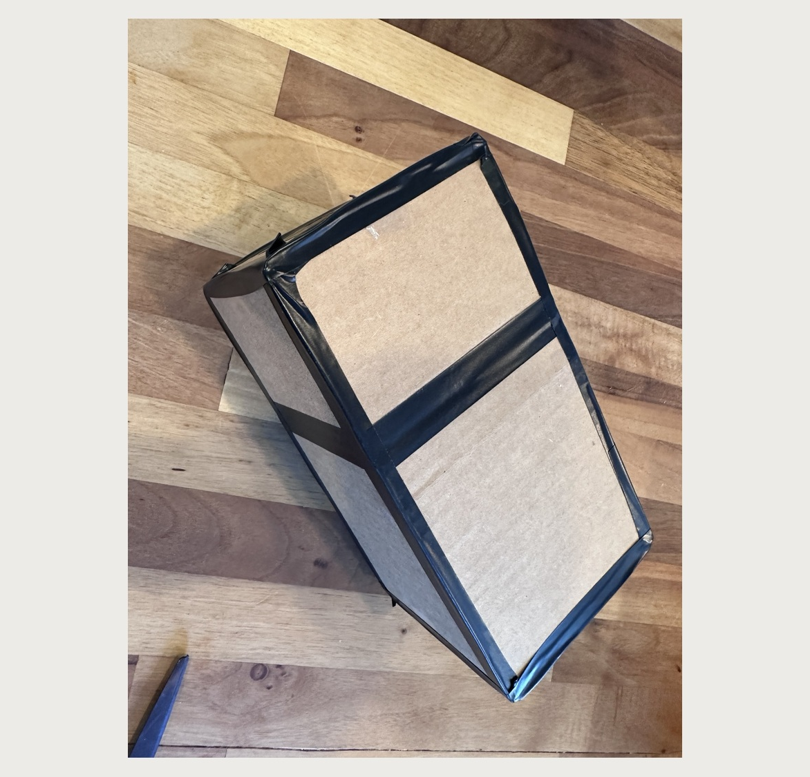
PINHOLE CAMERA
FOR CELL PHONES
A hands-on build that turns a phone into a simple camera obscura viewer.
WA-ACTE Summer Conference 2026 • Spokane
Paul Warrick
Notes:
Open by framing this as a fast build session. The goal is a working small pinhole camera with the black surfaces inside and sealed edges to block stray light.

Slide 2
What we are building
A small cardboard pinhole camera with a translucent screen and a sealed pinhole end.
By the end, participants should have:
A folded camera body with black surfaces facing inward
A translucent viewing screen installed inside
A pinhole insert centered and taped at the front
All light leaks sealed with black tape
A simple viewer that demonstrates how light travels through a small opening
Notes:
Use this slide to preview the build and explain the two non-negotiables: black inside and light sealed.

Slide 3
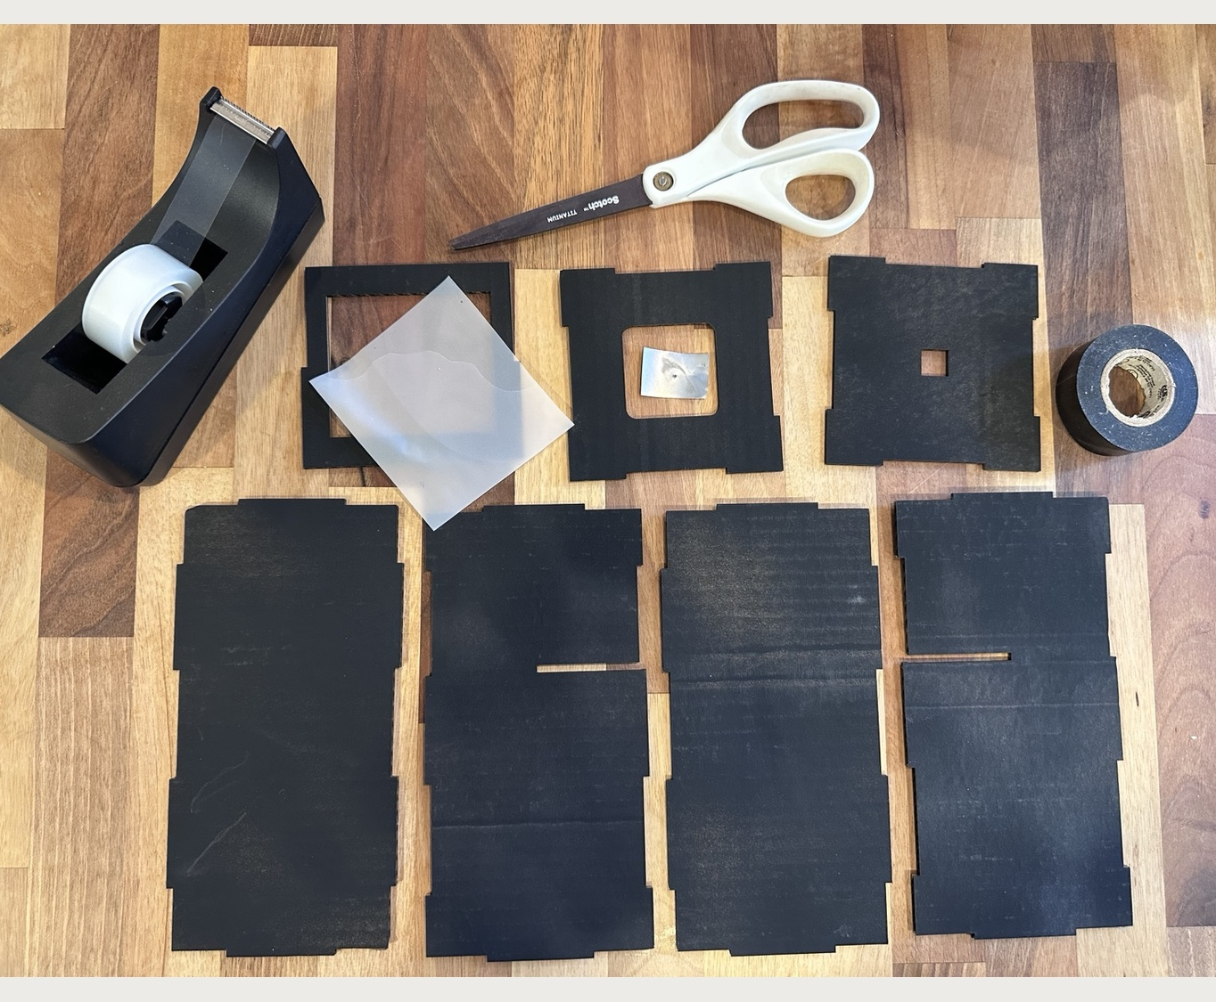
Before we start
Clear tape builds the camera. Black tape blocks stray light.
Materials
Camera body pieces
Scissors
Clear or transparent tape
Black tape
Translucent screen material
Pinhole insert
Lay everything out and confirm all parts before taping.
Notes:
The instruction sheet begins with gathering materials and confirming parts. Keep clear tape and black tape roles separate.

Slide 4
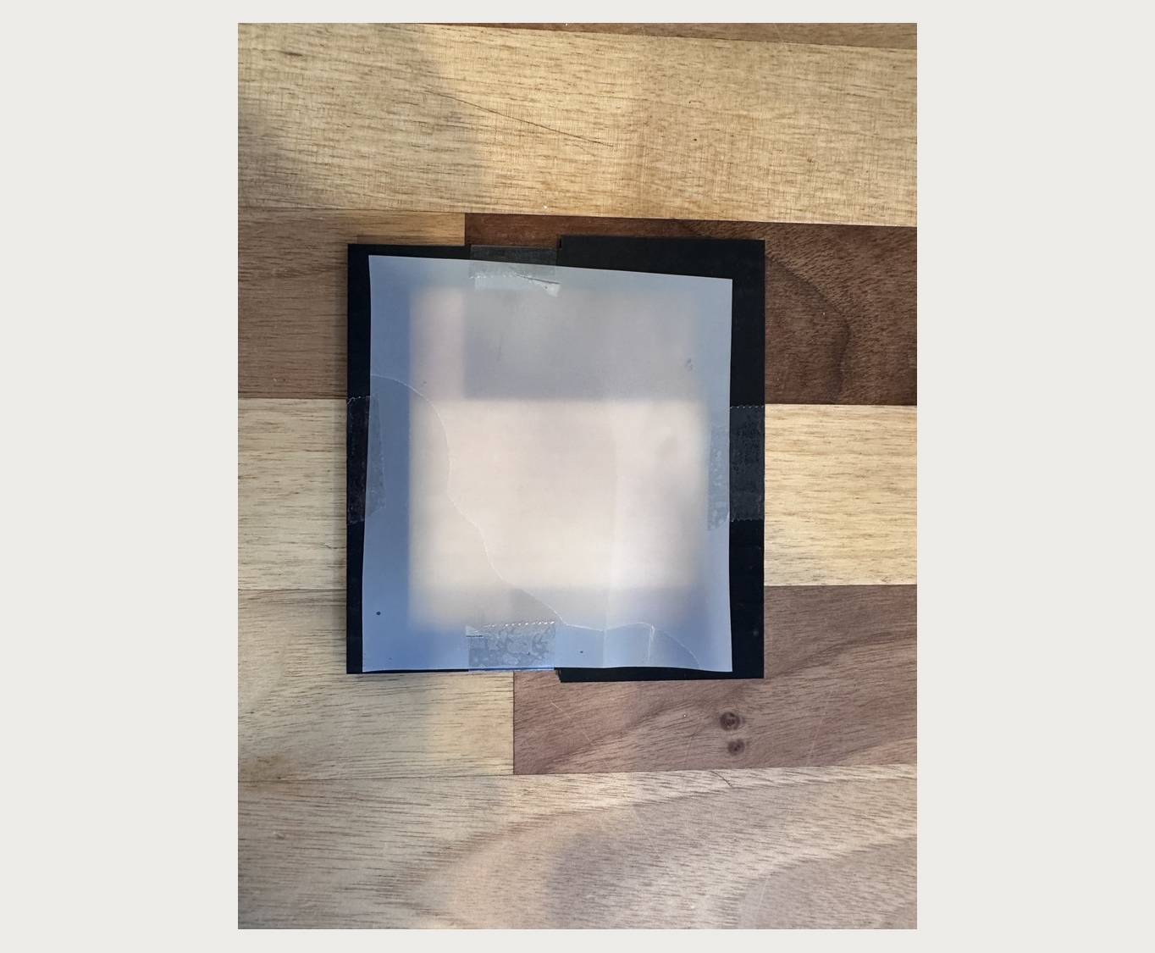
PREPARE THE SCREEN
2
WHAT TO DO
Attach tissue paper, tracing paper, or scrim material to the black side of the screen frame with transparent tape.
DETAILS
Keep the material flat and cover the entire opening. Trim excess if needed.
Black side faces the camera interior.
Notes:
Step 2: Prepare the screen. Attach tissue paper, tracing paper, or scrim material to the black side of the screen frame with transparent tape. Details: Keep the material flat and cover the entire opening. Trim excess if needed.

Slide 5
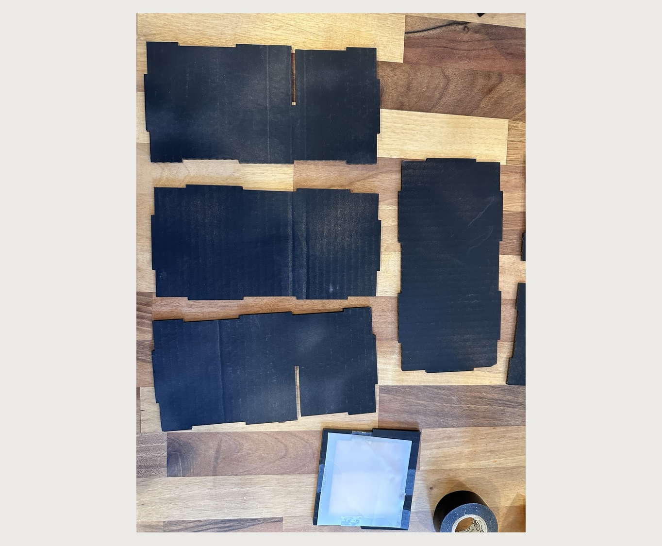
FORM THE BODY
3
WHAT TO DO
Lay out the long body pieces to create a bottom and two side walls. Fold the bottom and sides together, then use clear tape to hold seams temporarily.
DETAILS
Keep black surfaces facing inward. Align tabs and edges before taping.
Clear tape is a temporary hold here.
Notes:
Step 3: Form the body. Lay out the long body pieces to create a bottom and two side walls. Fold the bottom and sides together, then use clear tape to hold seams temporarily. Details: Keep black surfaces facing inward. Align tabs and edges before taping.

Slide 6
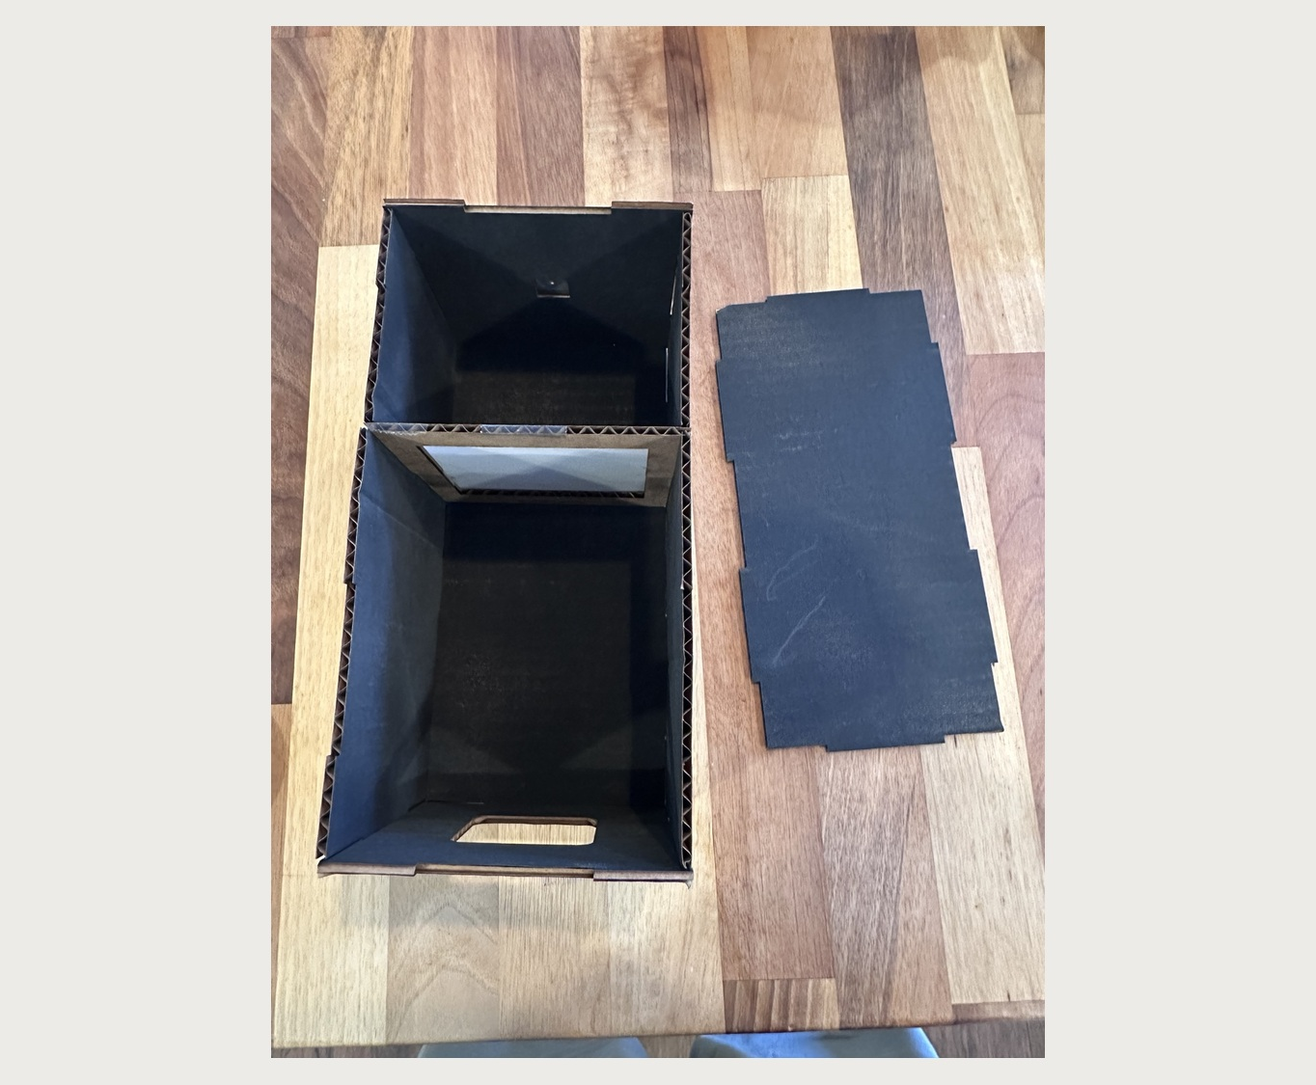
ADD ENDS + SCREEN
4
WHAT TO DO
Tape the large square-opening end to the larger section. Tape the small square-opening end to the smaller section. Secure the screen frame inside.
DETAILS
The screen frame black side faces the smaller section. The small opening is where the pinhole goes.
Check orientation before sealing.
Notes:
Step 4: Add ends + screen. Tape the large square-opening end to the larger section. Tape the small square-opening end to the smaller section. Secure the screen frame inside. Details: The screen frame black side faces the smaller section. The small opening is where the pinhole goes.

Slide 7
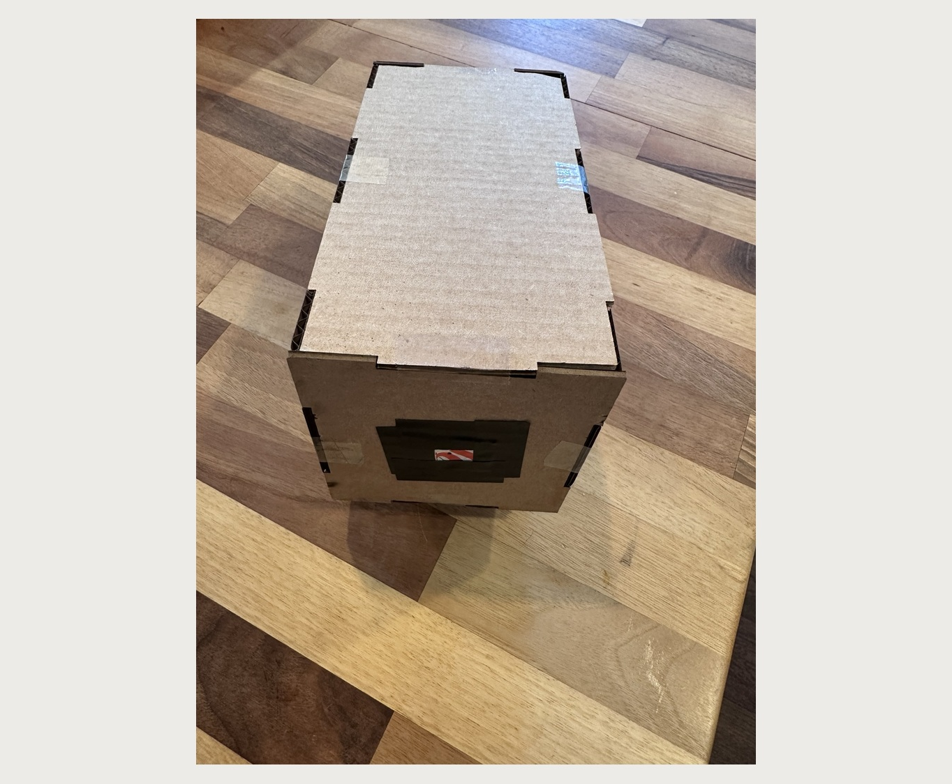
CLOSE BOX + ADD PINHOLE
5
WHAT TO DO
Use clear tape to attach the top panel and close the box. Center the pinhole insert over the small square opening and secure it with black tape.
DETAILS
Do not cover the tiny pinhole in the center.
Tiny hole must stay open.
Notes:
Step 5: Close box + add pinhole. Use clear tape to attach the top panel and close the box. Center the pinhole insert over the small square opening and secure it with black tape. Details: Do not cover the tiny pinhole in the center.

Slide 8
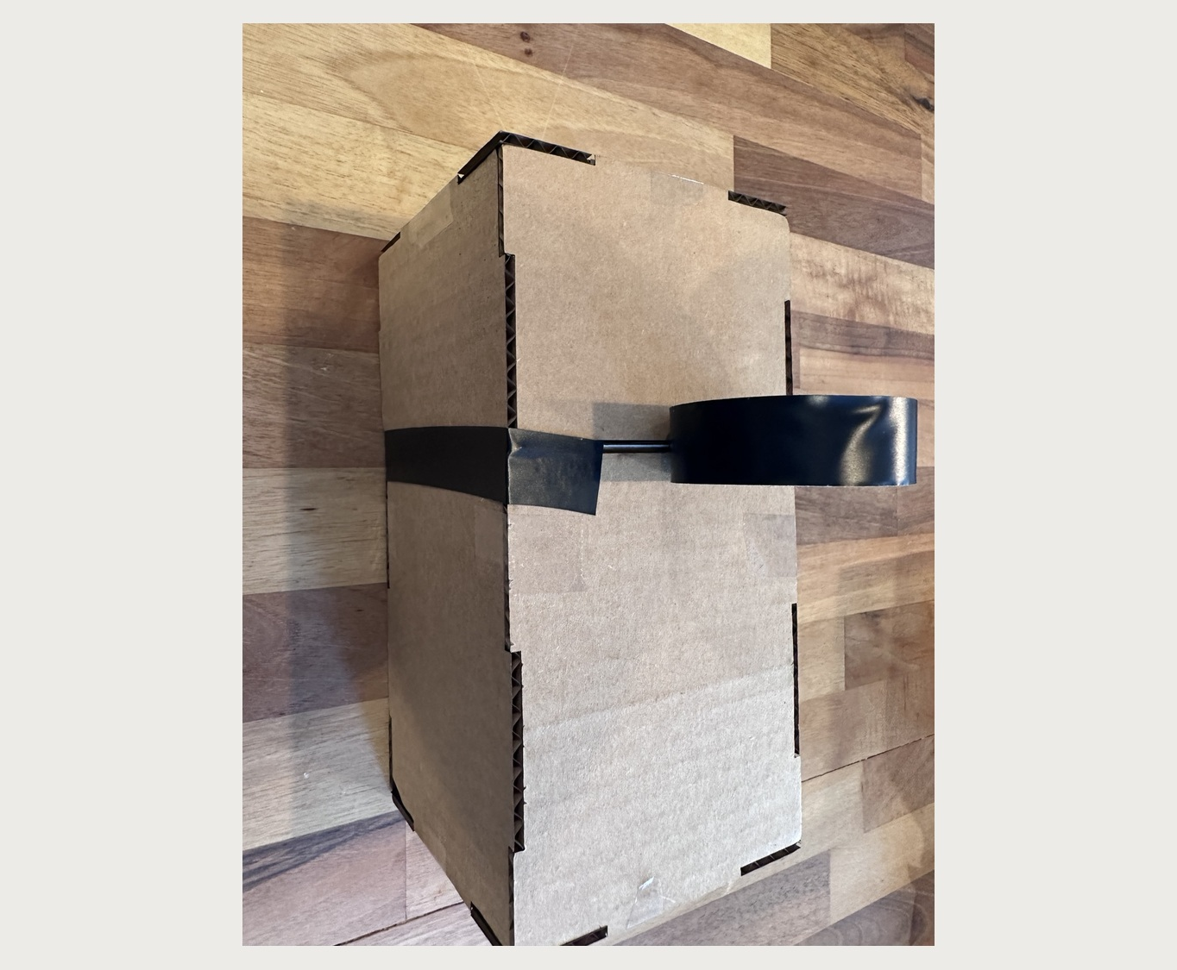
WRAP THE CENTER SEAM
6
WHAT TO DO
Wrap black tape all the way around the box at the screen-frame divider. Cover the seam and gaps around the full camera.
DETAILS
Overlap the tape slightly and press firmly against every corner.
Seal light leaks at the divider.
Notes:
Step 6: Wrap the center seam. Wrap black tape all the way around the box at the screen-frame divider. Cover the seam and gaps around the full camera. Details: Overlap the tape slightly and press firmly against every corner.

Slide 9
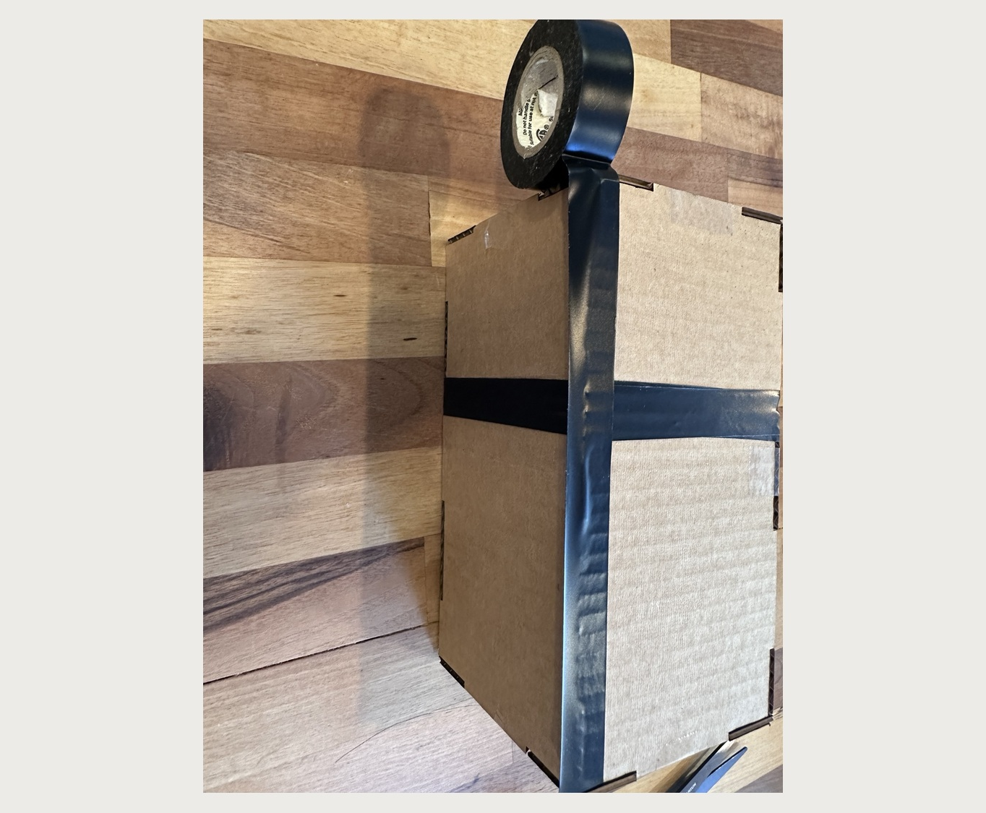
TAPE THE LONG EDGES
7
WHAT TO DO
Run black tape along the long outer edges and corner seams. Fold the tape over each edge so both adjoining panels are sealed.
DETAILS
Press out wrinkles and cover exposed cardboard gaps. Stretching the tape can help it curl over the edge.
Edges leak light first.
Notes:
Step 7: Tape the long edges. Run black tape along the long outer edges and corner seams. Fold the tape over each edge so both adjoining panels are sealed. Details: Press out wrinkles and cover exposed cardboard gaps. Stretching the tape can help it curl over the edge.

Slide 10
SEAL EVERY EDGE
8
WHAT TO DO
Finish covering all remaining seams and exposed edges with black tape. Check the camera for openings where stray light might enter.
DETAILS
The camera is complete when every seam is sealed except the large viewing opening and the tiny pinhole.
Leave only two openings: viewer and pinhole.
Notes:
Step 8: Seal every edge. Finish covering all remaining seams and exposed edges with black tape. Check the camera for openings where stray light might enter. Details: The camera is complete when every seam is sealed except the large viewing opening and the tiny pinhole.

Slide 11
Test and troubleshoot
If the image is weak, check light leaks before changing the pinhole.
Quick checks
Cup your hand around the viewing end to block room light
Aim at a bright window, lamp, or outdoor scene
Look for light leaks along seams and corners
Confirm the pinhole is not covered by tape
Reseal with black tape before rebuilding anything
Notes:
Students should troubleshoot with light leaks first. Remind them the camera needs darkness inside and only the pinhole should admit light.

Slide 12
Facilitation plan
A simple build runs best with visible checkpoints.
0–5 min
5–15 min
15–25 min
25–35 min
35–40 min
Materials + screen
Fold body + add ends
Close box + pinhole
Seal seams
Test + questions
Stop points
Before closing: black surfaces inside
Teacher move: keep one finished camera visible and one partly built model nearby.
Before pinhole: small square opening visible
Before testing: every seam sealed with black tape
Notes:
Use this to keep the room moving. The slide supports a 40-minute hands-on session.

Slide 13

Resources and contact
Scan once for conference resources, contact information, and follow-up materials.
What you will find there
Pinhole camera build instructions
Conference slide decks
Contact information
LaserSloth Media updates
laserslothmedia.com/wacte2026
Book and workshop resources
Thank you
Notes:
Close with the shared WA-ACTE QR code and remind participants the same resource page can host all three session materials.

